Slide 1
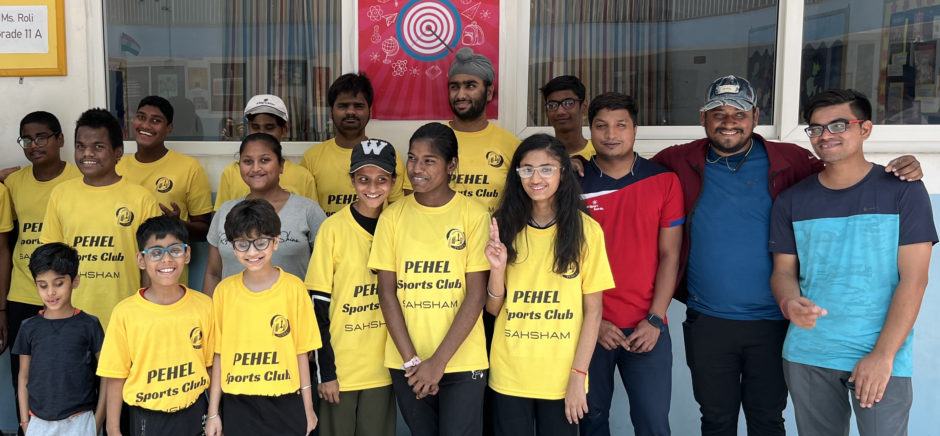
BRAND GUIDELINES
ALTIUS
BRAND GUIDELINES
Reduce ambiguity and provide clear direction to your teams and partners on branded assets. A single source for brand and marketing guidelines to keep up-to-date on the latest trends.

Slide 2
Index
Introduction. About the Brand. Brand Logo. Brand Colours. Typography. Visual Style. Glossary.
BRAND GUIDELINES
ALTIUS

Slide 3
Introduction
BRAND GUIDELINES
Step into the realm of Altius, in these pages we’ve unveil the core elements that mould and binds - the world of Altius
ALTIUS

Slide 4
Introduction
Welcome to the Altius Brand Identity Guidelines, meticulously curated to steer a refined approach to visual communication across digital platforms. This comprehensive guide serves as a directive for individuals duly authorized to represent the Altius brand.
Our brand stands not just as an identity but as a strict cultivated reputation that demands utmost fidelity. We adhere strongly to elevated standards and anticipate nothing short of excellence wherever our brand finds representation.
This guide is meant to celebrate the creative spirit, and innovation that is ingrained in our core values. We aim for a harmonised, reliable, and impactful brand representation in everything we produce.
While specific brand executions and graphic elements, such as business cards and letterheads, adhere to standardized formats, this guide transcends those particulars. Its primary focus is to empower—the creative mind—with the essential elements needed for unique crafting.
By embracing these tools, leveraging available resources, and adhering to the outlined guidelines, you'll consistently produce content that encapsulates the ethos of the Altius brand. We encourage regular reference to this guide. For any inquiries or assistance, do not hesitate to reach out to our Design Team at [Design Team Contact Information]."
Altius serves as a platform for athletes to connect, communicate and educate. It empowers players from diverse sports to effortlessly organize, conduct and represent.
ALTIUS

Slide 5
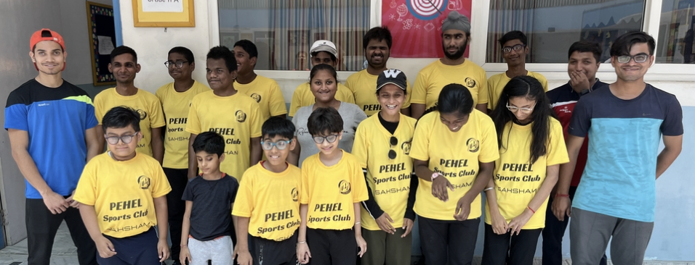
About the Brand
BRAND GUIDELINES
Altius is a commitment to inclusivity and equality. The platform redefines the way individual athlete connect, communicate, and engage. It endeavors to create a vibrant and empowering space where every athlete represents themselves authentically.
This platform serves as a catalyst for forging connections, fostering sports education, empower to organize and conduct multiple events-tournaments and celebrate the diverse talents of athletes.
ALTIUS

Slide 6
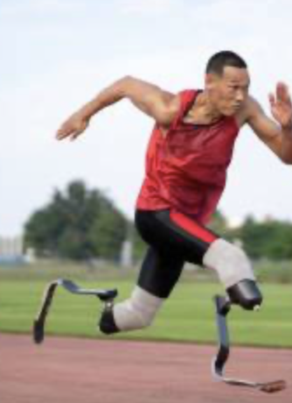




Core Values
Inclusive_Inspirational_Proactive Passionate_ Courageous_Athletes Connective_Communicative
ALTIUS

Slide 7
~ Equality Matters Inclusivity Matters ~
MISSION & VISION
Mission & Vision
Altius is a commitment to inclusivity and equality.
Support organisations and communities that will have access to our platform.
Promote success stories of athletes and organisations.
Expand our group of diverse narrators, program developers and researchers.
Seek diversity for our investors and collaborators.
Educate ourselves to support inclusivity, and empower ourselves with knowledge that embraces diversity with open arms.
ALTIUS

Slide 8
BRAND GUIDELINES
YELLOW GREEN RGB 144/194/38 CMYK 26/0/80/24 HEX #90c226
Brand colors
DARK GREY RGB 127/127/127 CMYK 0/0/0/50 HEX #7f7f7f
WHITE RGB 255/255/255 CMYK 0/0/0/0 HEX #FFFFFF
ALTIUS

Slide 9
BRAND GUIDELINES
TREBUCHET (MS)
Extralight
Light
Regular
Medium
Bold
Extrabold
Typography
ALTIUS

Slide 10
BRAND GUIDELINES
Every brand needs a visual guide
It represents the graphical culmination of our strategic efforts, manifesting as a visual embodiment of our brand identity. This guide constructs a comprehensive and cohesive system that addresses diverse considerations from physical constraints to modern media platforms. At it’s heart, the system is anchored by a distinctive brand signature- a logo, wordmark, or logotype serving as the trademark of brand. This primary identifier is complemented by meticulously developed patterns, color palettes, and typographic systems. These elements, in harmony, define a unique graphic style for the brand. As a result of design process, it's imperative to consider and build a range of variants that cater to diverse needs, ensuring ease of use and effective presentation across all sizes and environments. Concepts that are to be evaluated within the context of real-world communications, prioritizing critical touchpoints such as stationery, collateral, website, and physical environments that ensures strategic and impactful alignment of the brand's goal. Consideration is given to both the primary brand lockup and potential extensions, geographic signifiers and essential alternates.
Visual Style
ALTIUS

Slide 11
BRAND GUIDELINES
CORPORATE IDENTITY
LOGO
Corporate identity is the visual and portrayal of a company's image held by its diverse audience, including customers, investors, and employees. The company's communication department plays a pivotal role in cultivating and reinforcing this image to align with and advance business goals.
A logo is visual symbol or emblem frequently employed by businesses, organizations, and individuals to facilitate and enhance immediate public recognition. Logos can take the form of purely graphic symbols/icons or incorporate the organization's name, creating a distinct logotype or wordmark.
Glossary
IDENTITY MANNUAL
BRAND ARCHITECTURE
An identity manual is a formal reference document that outlines technical and creative standards for a visual identity system. It typically includes detailed specifications for reproducing the logo or logotype, guidelines for the stationery system, instructions for common print and web applications, and examples of proper usage on various merchandise.
Brand architecture is the structural framework that delineates the relationships and interactions among a company's individual brands. It establishes the roles and hierarchy of each brand within the overall corporate structure, clarifying their functions. This framework empowers companies to differentiate their brand elements, develops clarity and coherence in their brand strategy.
ALTIUS

Slide 12

BRAND GUIDELINES
Explore further resources by visiting our website “ ”. For additional information, please reach out to our brand office via email at “ ”
Resources
ALTIUS

